Slide 1
Towards Battery-free HD Video Streaming
Saman Naderiparizi, Mehrdad Hessar, Vamsi Talla, Shyam Gollakota and Joshua R. Smith

Slide 2
Snap Spectacle
Batteries add weight
Has heating issues
No video streaming

Slide 3
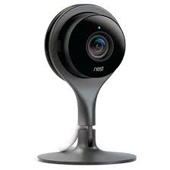
Nest Camera
Needs to be plugged into power

Slide 4
Grand Challenge
Design sticker form-factor battery-free camera tags

Slide 5
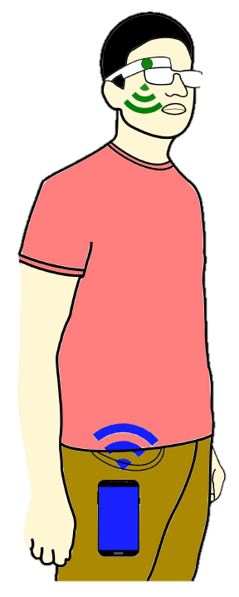
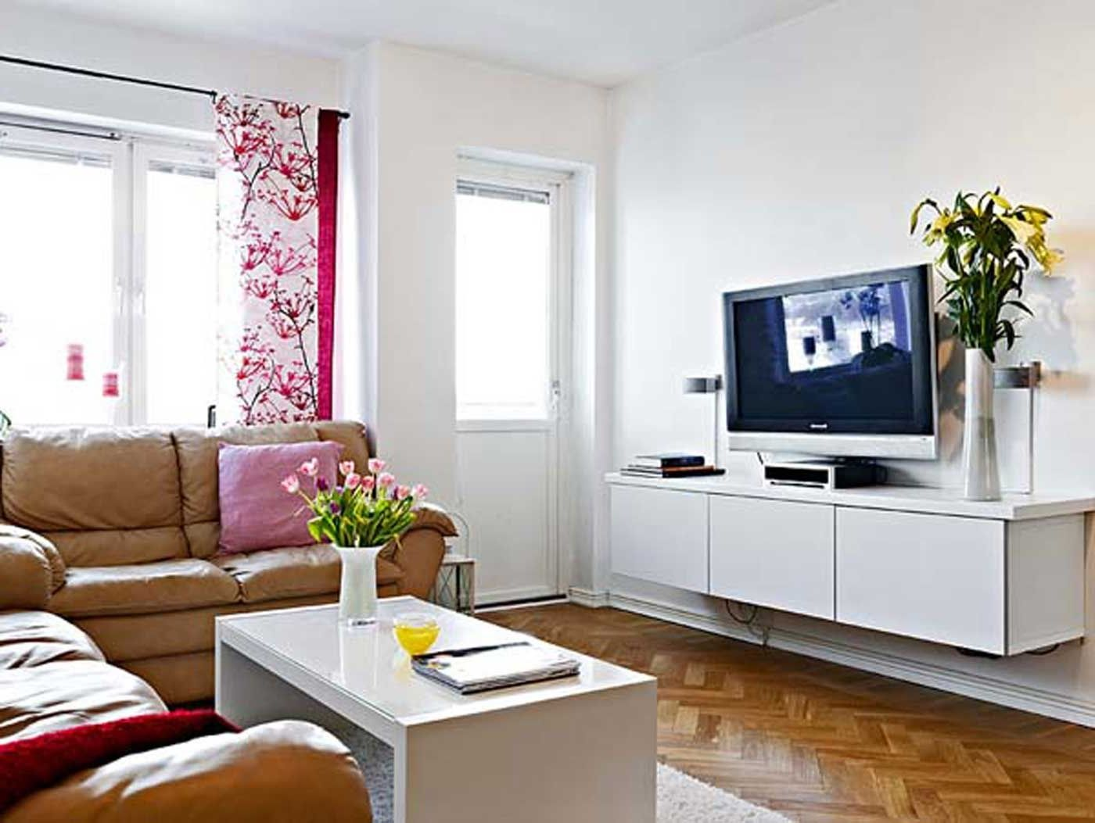
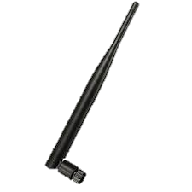
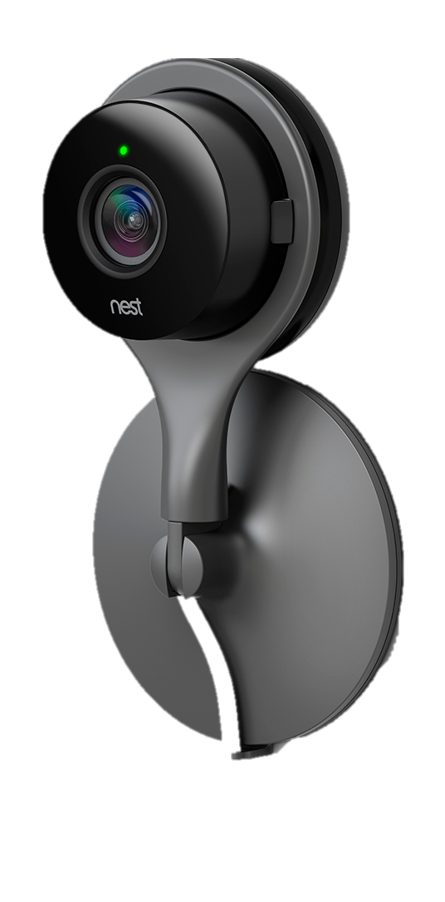
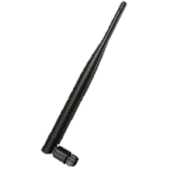
Our Vision of Battery-free Cameras
Hub

Slide 6
Challenge: Video Streaming is Power Hungry
…
Digital
Compression
…
…
ADC
COM
…
Image Sensor
At 720p 30fps grayscale
Image sensor: 85uW
ADC: 2mW
Digital Compression: 1W
Radios: 100mW
Total >1W

Slide 7
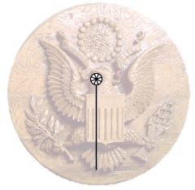
We Take Inspiration from the Great Seal Bug
Tx
Radio
Rx
Achieve Low-power Video Streaming
Tx
…
Hub
…
…
…
Rx
Image Sensor

Slide 8
Contributions
First demonstration of analog video backscatter that sends pixels directly to the antenna
Evaluated with multiple prototypes & simulations
HD prototype with offline processing of 10fps grayscale 720p analog video backscatter at up to 14ft
Spec out an IC that shows 30fps 720p and 1080p video at 252uW and 560uW respectively
Live prototype of a 112x112 13fps video stream at 27ft

Slide 9
Recorded Demo
Ultra Low Power HD Video Streaming

Slide 10
Real-Time Demo
112 X 112 Resolution Video Streaming

Slide 11
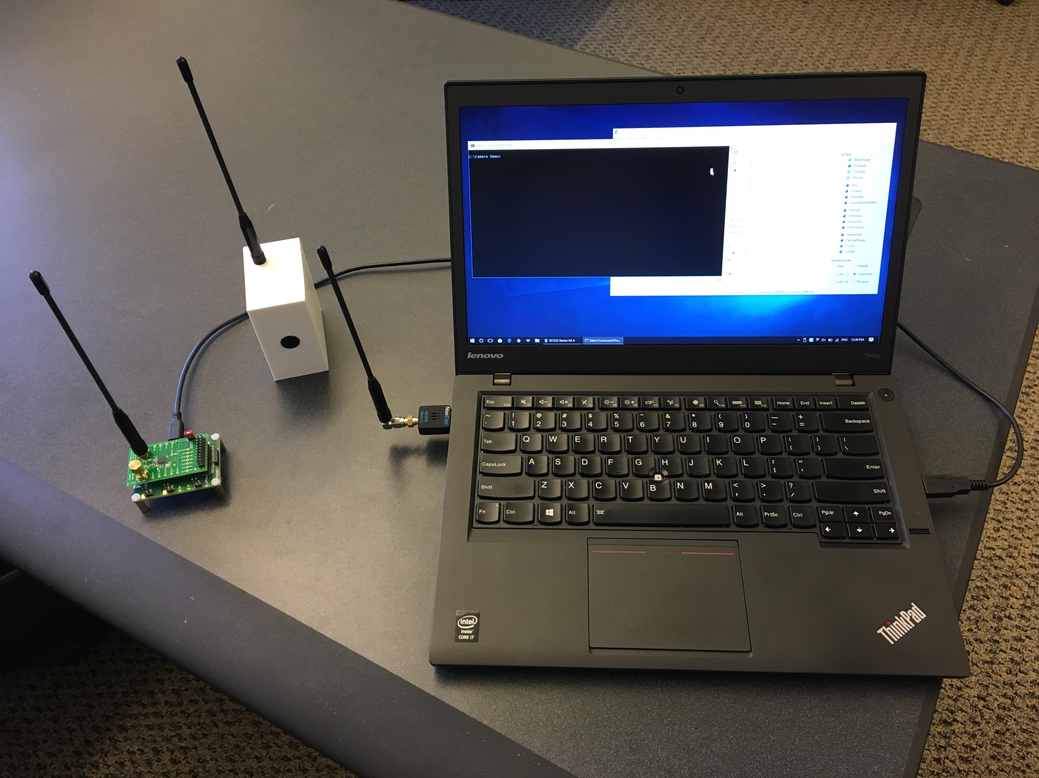
Demo 2
Receiver
Low-resolution
camera
Single tone
transmitter

Slide 12
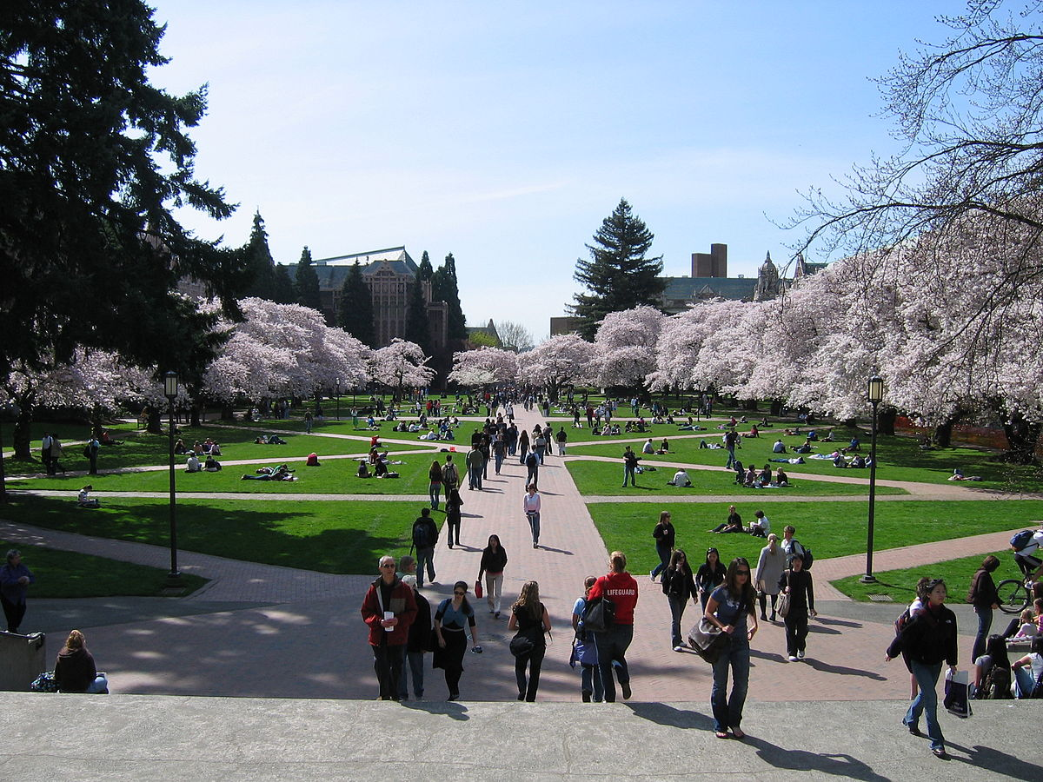
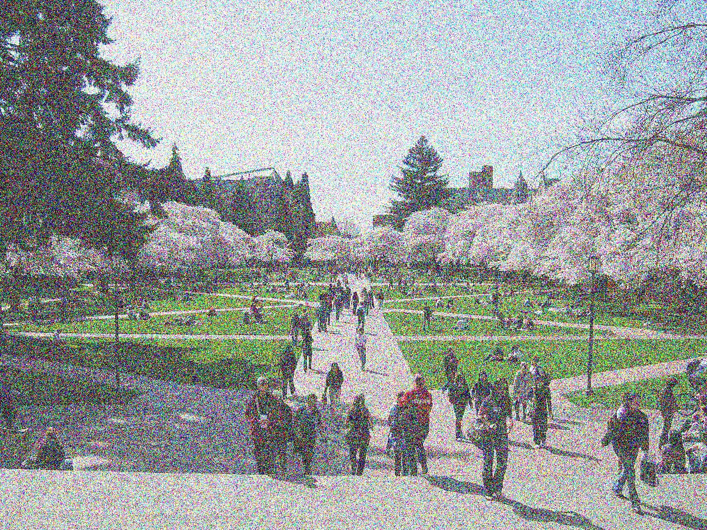
Technical Challenges
Analog video has lower quality than digital video
Benefits of digital compression are lost in analog
720p @ 30fps -> 221 Mbps uncompressed rate
1080p @ 30fps -> 500 Mbps uncompressed rate
…
…
…
…
Analog Pixel Values
Hub
Image Sensor
Analog Pixel Values
Received Signal
Original
Image
Received
Image

Slide 13
Solution 1: Inspiration from Human Brain Signals
Neuron Spiking Signal
Received Signal
Received Image
Analog
Pixels
Pulse-width
Modulation

Slide 14
Solution 1: Inspiration from Human Brain Signals
We create pulse width modulated pixels using analog hardware
Triangular Wave
…
PWM Signal
V_{max}
…
…
V_{min}
-
+
…
Comparator
V_{max}
Image Sensor
V_{min}
“Analog” Signal
Overcome the curse of analog video

Slide 15
Technical Challenges
Analog video has lower quality than digital video
Benefits of digital compression are lost in analog
Analog signals are more
susceptible to noise
Compression
Intra-frame compression
Inter-frame compression

Slide 16
Our Intra-Frame Compression
Adjacent pixels are fairly similar
We send video in zig-zag manner
Reduces average wireless bandwidth
Across 100 HD-resolution YouTube videos
Reduces BW for 720p@30 analog video 70x

Slide 17
Our Inter-Frame Compression Algorithm
What kind of operation can we perform?
Analog Domain
Low-power
Averaging Operation
$$I_{o}$$
$$I_{1}$$
Super-pixel average output
$$I_{2}$$
Analog pixel output
$$I_{3}$$
Image Sensor
(2×2 Pixels)
Analog signals are more
susceptible to noise
Compression
Intra-frame compression
Inter-frame compression

Slide 18
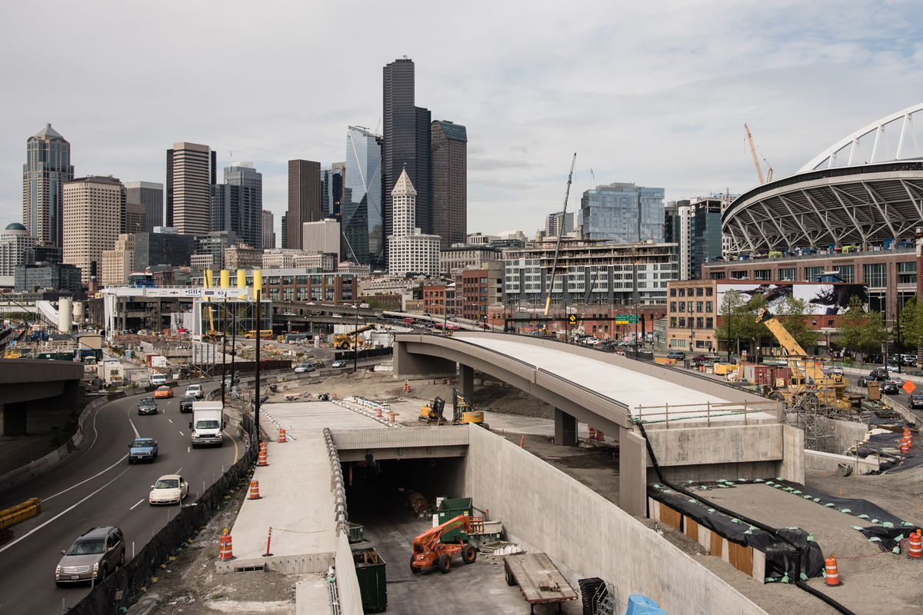
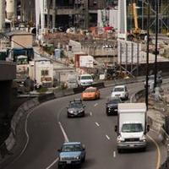
Our Inter-Frame Compression Algorithm
Low-power analog computation → super-pixel
Distributed compression algorithm
100 px
5 super-pixel
100 px
5 super-pixel
Request super-pixel regions
Hub
Hub performs inter-frame comparison for compression

Slide 19
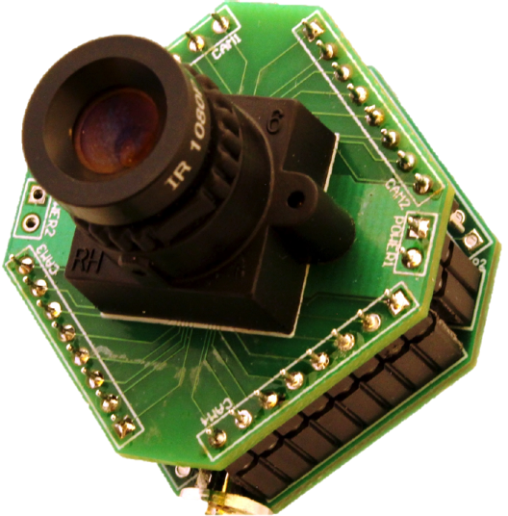
Implementation
HD video streaming prototype
Play HD videos from a PC to a DAC
Custom backscatter switch
Low-resolution video streaming prototype
112×112 grayscale low-power camera
Low-power Igloo Nano FPGA
Pixel Stream
Analog Signal
Our HD Prototype
DAC

Slide 20
Evaluation
We evaluate three main aspects
Quality of received videos
Our compression algorithm
Power consumption

Slide 21
Evaluation: HD Video Quality
Effective Number of Bits (ENOB)
ENOB (bits)
Original Image (8 bits)
7 bits
We achieve about ~6 bits at distance of 10 feet
Distance (in ft)
4 bits
3 bits

Slide 22
Evaluation: HD Video Quality (Mobility)
Effective Number of Bits (ENOB)
Put our prototype antenna on a participant head
We asked participant to perform different poses
ENOB (bits)
We achieve ENOB greater than 5 for all poses

Slide 23
Evaluation
We evaluate three main aspects
Quality of received videos
Our compression algorithm
Power consumption

Slide 24
Evaluation: Inter-Frame Compression Algorithm
We record videos from a normal lab space
We change super-pixel size to evaluate our algorithm
PSNR (dB)
Compression Ratio

Slide 25
Evaluation
We evaluate three main aspects
Quality of received videos
Our compression algorithm
Power consumption

Slide 26
Evaluation: Power Consumption
We spec out an IC to emulate power consumption
Verilog camera interface, PWM converter, & RF switches
TSMC 65nm LP Process
Frame Rate | 60 fps | 30 fps | 10 fps
Video Quality | Power (𝜇W) | Power (𝜇W) | Power (𝜇W)
1080p (1920×1080) | 806.50 | 560.63 | 167.77
720p (1280×720) | 320.94 | 252.10 | 78.31
480p (640×480) | 126.88 | 106.78 | 36.71
360p (480×360) | 75.63 | 65.68 | 25.11

Slide 27
Evaluation: Power Consumption
1080p @
60fps
Harvested Power
(in mW)
1080p @
60fps
1080p @
30fps
720p @
60fps
720p @
30fps
360p @
30fps
480p @
10fps
Distance (in ft)
Potential for battery-free video streaming

Slide 28
Grand Challenge
Design sticker form-factor battery-free camera tags

Slide 29
Trade-off and Road Ahead
Tradeoff between video quality and range
Explore advanced inter-frame compression
Build battery-free video streaming ASIC

Slide 30
Contributions
First demonstration of “analog” video backscatter that sends pixels directly to the antenna
Evaluated with multiple prototypes & simulations
HD prototype with offline processing of 10fps grayscale 720p analog video backscatter at up to 14ft
Spec out an IC that shows 30fps 720p and 1080p video at 252uW and 560uW respectively
Live prototype of a 112x112 13fps video stream at 27ft

