Slide 1
NetScatter: Enabling Large-Scale Backscatter Networks
Mehrdad Hessar*, Ali Najafi*, Shyam Gollakota
*Co-primary Student Authors

Slide 2
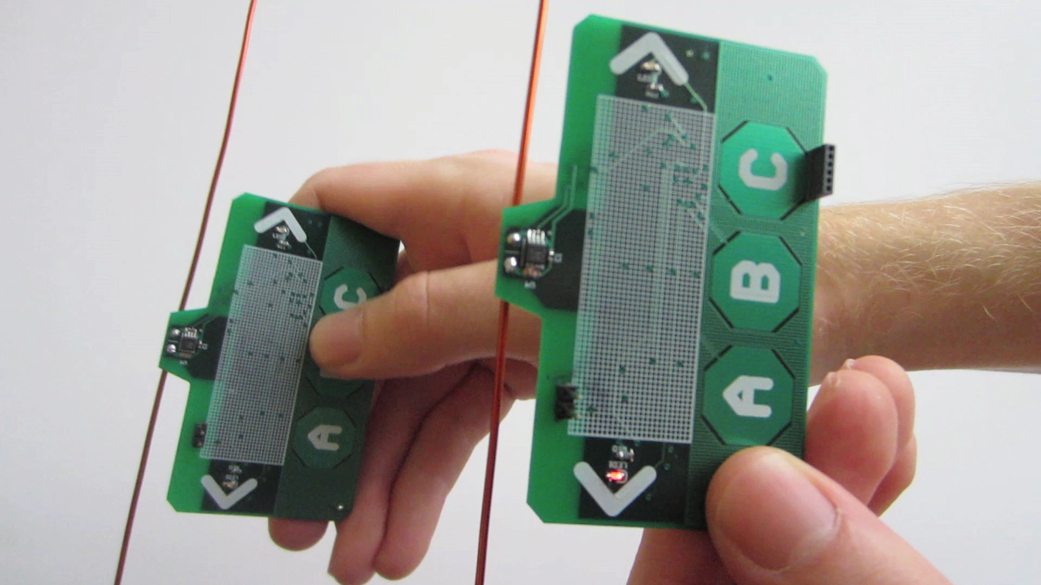
Backscatter Communication
Ambient
Backscatter
Passive
Wi-Fi
LoRa
Backscatter
10 years operation with a button cell battery
Low-cost (10 – 20 cents)
Long-range coverage (up to km)
SIGCOMM 2013
Best Paper
Award
NSDI 2016
Best Paper Award
UbiComp 2017
Distinguished Paper Award

Slide 3
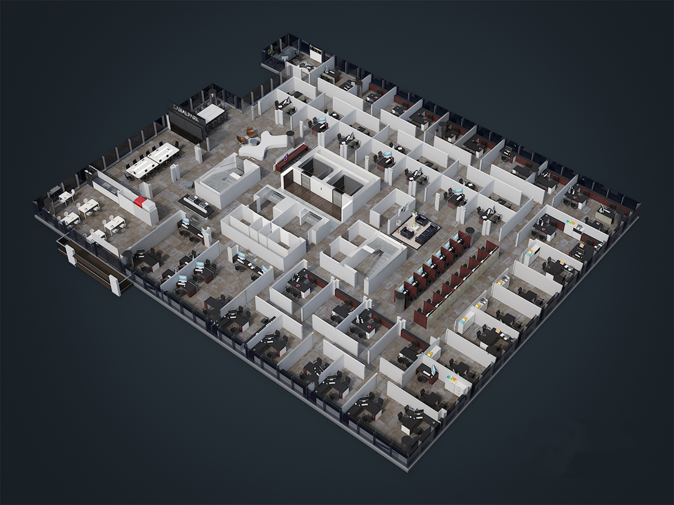
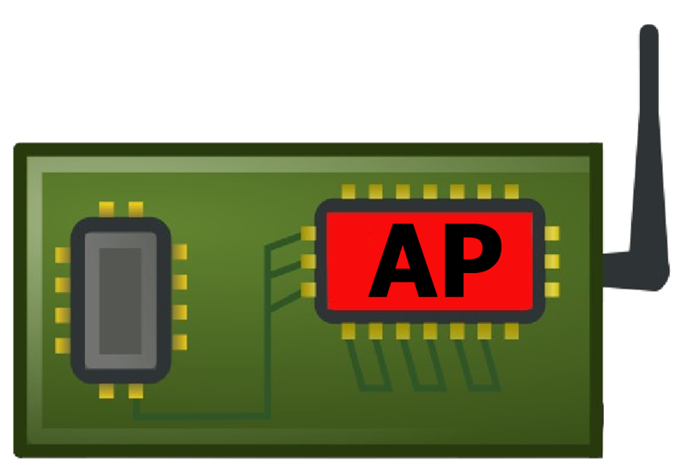
Grand Challenge: Long-Range Backscatter Network

Slide 4
NetScatter
First backscatter protocol supporting hundreds of concurrent transmissions
Distributed coding mechanism which works below noise floor and can be decoded using a single FFT
Network deployment of 256 devices using only 500 kHz
Improvements in PHY-layer data rate (7-26x), link-layer throughput (14-62x) and network latency (15-67x)

Slide 5
Outline
Distributed Chirp Spread Spectrum
Timing Synchronization
Near-Far Problem
Deployment of 256 devices

Slide 6
Chirp Spread Spectrum
Bit ‘0’
Bit ‘1’
$$Freq$$
$$Freq$$
$$f$$
$$f$$
$$Time$$
$$Time$$
$$−f$$
$$−f$$
Amplitude
Amplitude
$$1$$
FFT Bin
$$N$$
$$1$$
FFT Bin
$$N$$
Supports high sensitivity and long-range

Slide 7
Drawbacks of Chirp Spread Spectrum
Data rate vs range trade-off
TDMA network (each device 1 kbps)
100 devices in network
1000 devices in network
→ 10 bps
→ 1 bps

Slide 8
Our Key Observation
Bit ‘1’
$$Freq$$
$$f$$
$$Time$$
$$−f$$
Amplitude
$$1$$
FFT Bin
$$N$$
Empty FFT Bins

Slide 9
Our Idea: Distributed CSS
We assign each cyclic shift to a backscatter device
Each device uses ON-OFF keying on cyclic-shift to communicate
Alice: Bit ‘1’
Bob: Bit ‘1’
Alice: Bit ‘1’
Bob: Bit ‘0’
Alice: Bit ‘0’
Bob: Bit ‘1’
Alice: Bit ‘0’
Bob: Bit ‘0’
More power in the network → Higher network rate
$$Freq$$
$$Freq$$
$$Freq$$
$$Freq$$
$$f$$
$$f$$
$$f$$
$$f$$
$$t$$
$$t$$
$$t$$
$$t$$
$$−f$$
$$−f$$
$$−f$$
$$−f$$
Amplitude
Amplitude
Amplitude
Amplitude
$$1$$
FFT Bin
$$N$$
$$1$$
FFT Bin
$$N$$
$$1$$
FFT Bin
$$N$$
$$1$$
FFT Bin
$$N$$

Slide 10
Network of Hundred Backscatter Devices
Single FFT
9
Amplitude
9
9
9
9
9
$$…$$
$$1$$
$$2$$
$$3$$
4
5
$$100$$
Access Point
FFT Bin
. . .

Slide 11
How Many Concurrent Transmissions Can We Support?
Typical LoRa configuration
Uses 500 kHz BW
512 cyclic-shifts
Theoretically, we can support 512 concurrent transmissions using only 500 kHz BW

Slide 12
Outline
Distributed Chirp Spread Spectrum
Timing Synchronization
Near-Far Problem
Deployment of 256 devices

Slide 13
Practical Issues: Timing Synchronization
Alice and Bob
Synchronized
Not synchronized
Freq
Freq
$$\frac{BW}{2}$$
$$\frac{BW}{2}$$
$$∆T$$
t
t
$$−\frac{BW}{2}$$
$$−\frac{BW}{2}$$
$$Time$$
$$Window$$
$$Time$$
$$Window$$
Amplitude
Amplitude
FFT Bin
FFT Bin
$$0$$
$$N$$
$$0$$
$$N$$
Causes interference between Alice and Bob

Slide 14
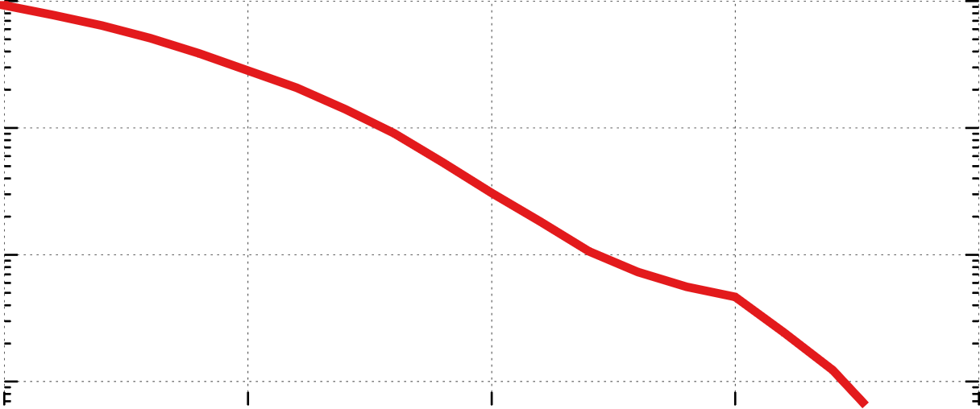
Timing Variation Across Devices
Hardware delay variations cause timing mismatch
$${10}^{0}$$
$${10}^{−1}$$
1-CDF
$${10}^{−2}$$
$${10}^{−3}$$
0
1
2
3
4
Time Variation (µs)
2 µs delay translates to 1 FFT bin with 500kHz BW

Slide 15
Timing Synchronization Solution
We use every other cyclic-shift
Amplitude
$$…$$
$$0$$
$$1$$
$$2$$
3
4
$$5$$
$$6$$
$$7$$
$$N$$
FFT Bin
Reduces concurrent transmissions from 512 to 256

Slide 16
Outline
Distributed Chirp Spread Spectrum
Timing Synchronization
Near-Far Problem
Deployment of 256 devices

Slide 17
Practical Issues: Near-Far Problem
Bob
Alice
Access Point
Amplitude
FFT Peak
FFT Bin

Slide 18
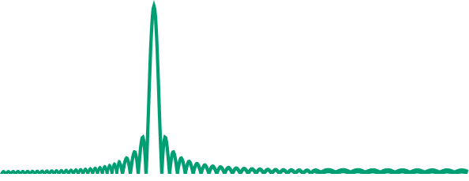
Solution: Power-Aware Cyclic Shift Assignment
Near Devices
Amplitude
Far Devices
FFT Bin
Similar power devices are clustered together

Slide 19
How to deal with changes in wireless channel?

Slide 20
Solution: Power Adaptation Algorithm
Each device uses AP’s query to self-adjusts its power
Achieve 0dB, -4dB and -10dB power gains
Starting power (-4 dB), increase power (0 dB), reduce power (-10 dB)
Typical Backscatter Devices
NetScatter
Switch Network
…
$$Z_{0}$$
$$Z_{1}$$
$$Z_{2}$$
$$Z_{M}$$

Slide 21
Outline
Distributed Chirp Spread Spectrum
Timing Synchronization
Near-Far Problem
Deployment of 256 devices

Slide 22
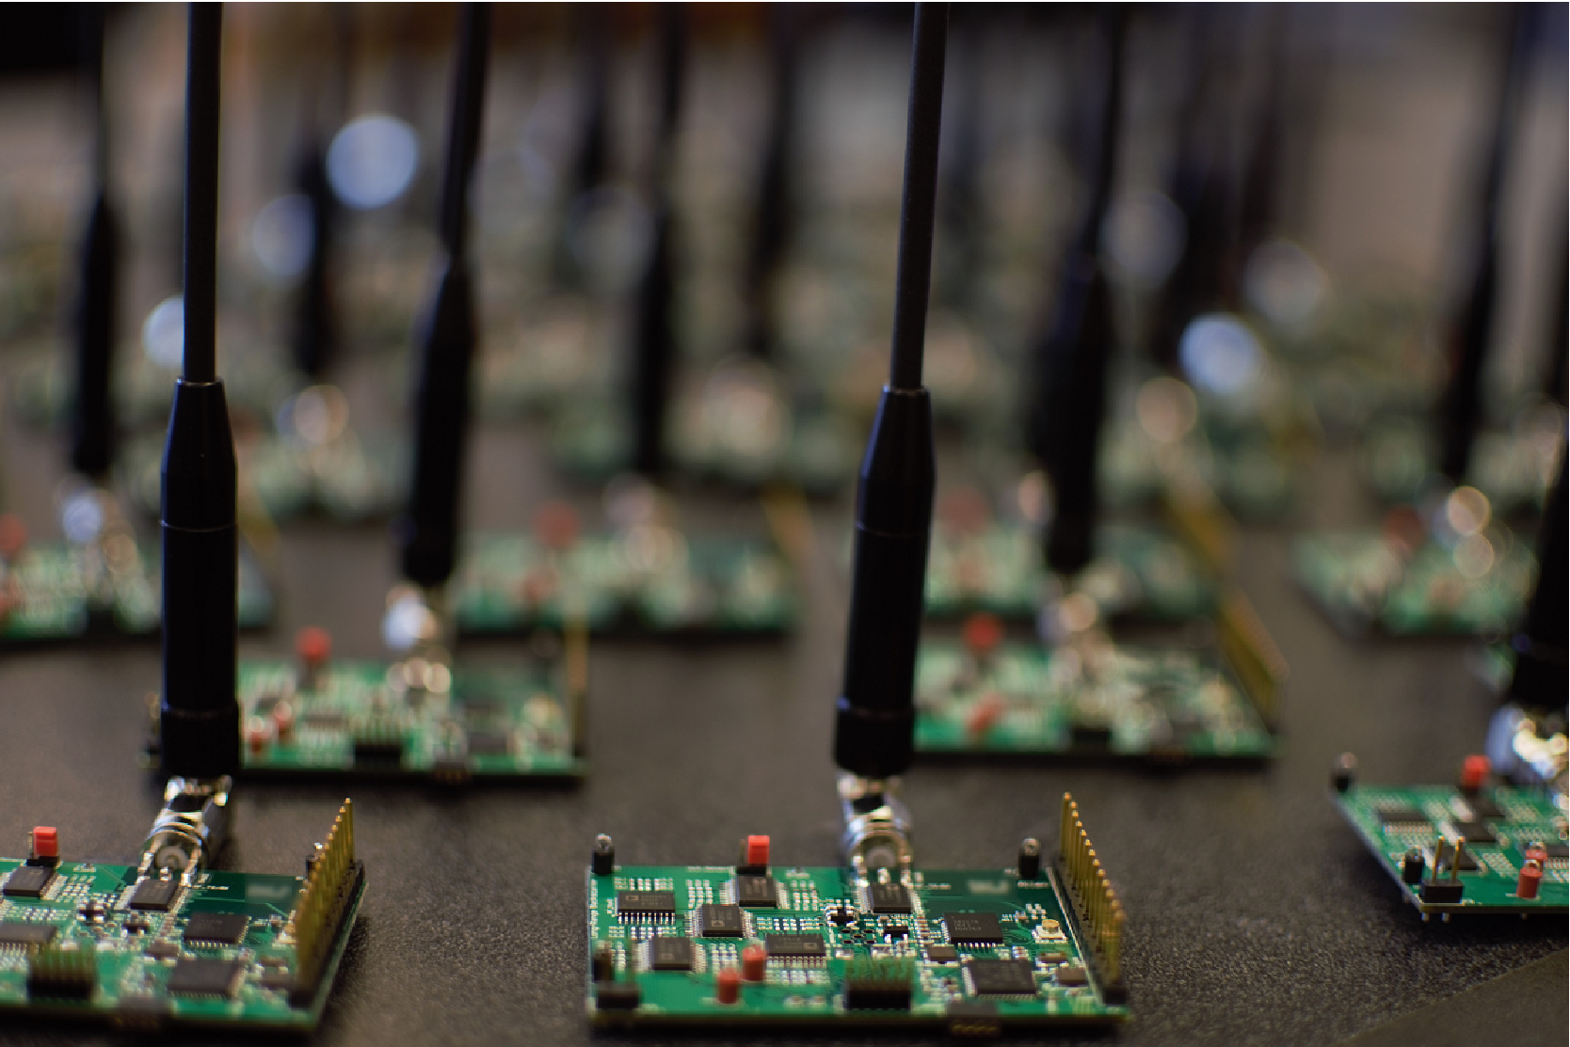
Implementation
Backscatter device
Baseband: IGLOO nano FPGA
Downlink: envelope detector
and MSP430
RF switch: ADG904
Three levels power adjustment
Access point
USRP X-300 with UBX-40 daughterboard
Co-located RX/TX antennas separated by 3 feet

Slide 23
Evaluation: Large-Scale Deployment
Access Point
Backscatter Device
71’
80’
We deployed a network of 256 devices in an office building

Slide 24
Evaluation
We compared NetScatter with:
LoRa-Backscatter (9 kbps)
LoRa-Backscatter with rate adaptation

Slide 25
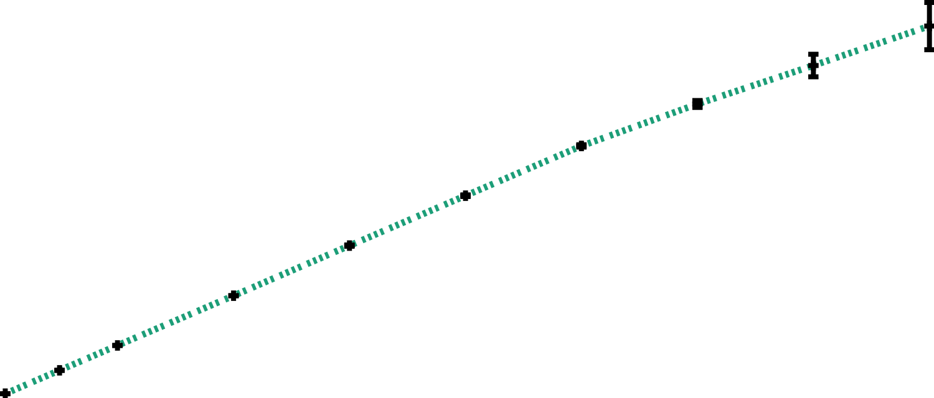
Evaluation: Network PHY Data-Rate
LoRa Backscatter (9 kbps)
NetScatter
LoRa Backscatter with Rate Adaptation
250
200
150
PHY Data Rate (kbps)
100
50
0
1
16
32
64
96
128
160
192
224
256
# of Backscatter Devices
PHY data-rate improves by 7x - 26x

Slide 26
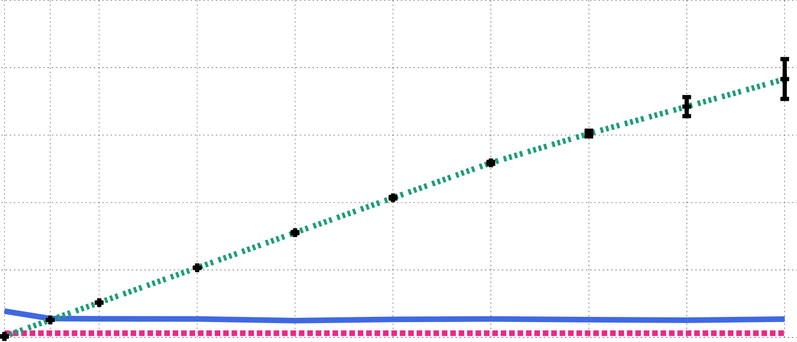
Evaluation: Link-layer data-rate
LoRa Backscatter (9 kbps)
NetScatter
LoRa Backscatter with Rate Adaptation
250
200
150
Link-Layer
Data Rate (kbps)
100
50
0
1
16
32
64
96
128
160
192
224
256
# of Backscatter Devices
Link-layer data-rate improves by 14x-62x

Slide 27
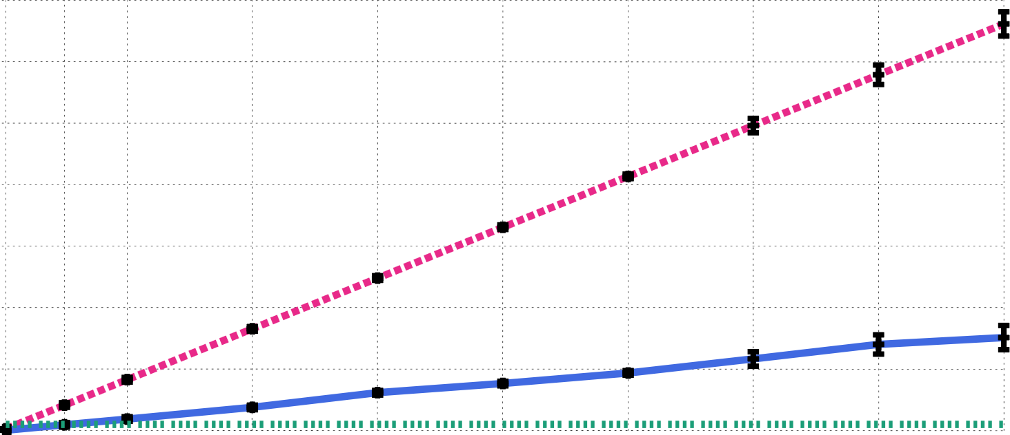
Evaluation: Network latency
LoRa Backscatter (9 kbps)
NetScatter
LoRa Backscatter with Rate Adaptation
3500
3000
2500
2000
Network Latency (ms)
1500
1000
500
0
1
16
32
64
96
128
160
192
224
256
# of Backscatter Devices
Network latency improves by 15x-67x

Slide 28
NetScatter
Access Point
Backscatter Device
71’
80’
We deployed a network of 256 devices in an office building

