Slide 1
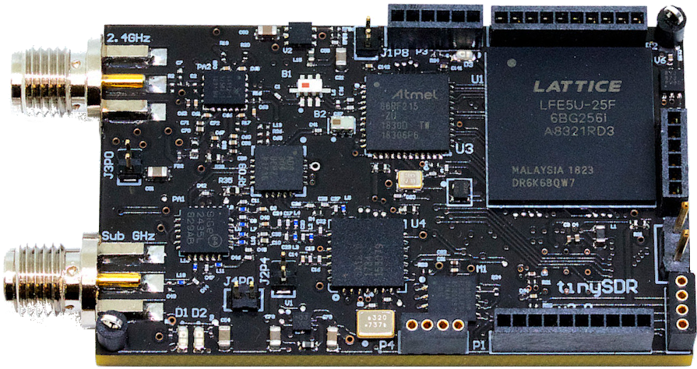
TinySDR
Mehrdad Hessar*, Ali Najafi*, Vikram Iyer, Shyam Gollakota
*Co-primary Student Authors

Slide 2
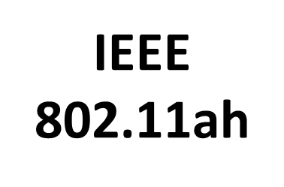
IoT Ecosystem is Fast-Changing
2009
2015
2016
2017
???

Slide 3
Academic community’s impact has been limited
Each protocol requires a dedicated inflexible chip
Many are proprietary → Little room for innovation
Can’t easily scale IoT testbeds or develop
new low-power protocols

Slide 4
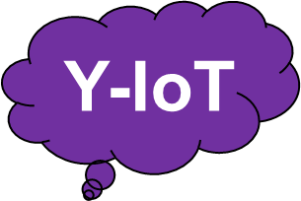
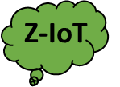
Ideal IoT Network Testbed
Battery-operated, duty-cycled SDR devices
9
9
9
9
9
9
9
9
9
9
9
9
9
9
9
9

Slide 5
SDR must model constraints of IoT endpoints
Support duty-cycle → Ultra-low power sleep mode
Battery-operated → Low-power tx/rx mode
Ability to update PHY and MAC over-the-air wirelessly
Support interfaces with sensors

Slide 6
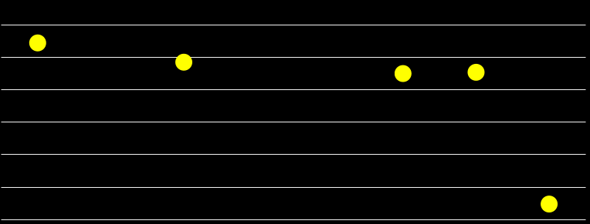
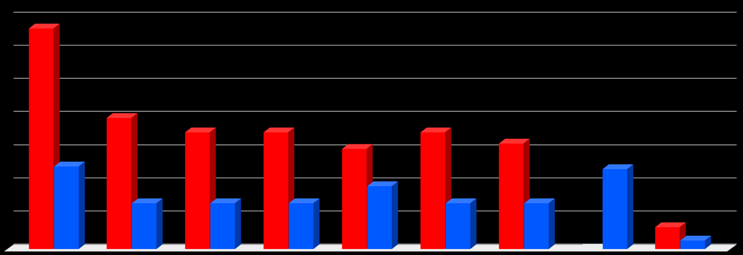
Existing SDRs don’t satisfy these requirements
Sleep power 10000 times too high
Radio module consumes high power for tx/rx
Require USB or Ethernet to update firmware
10000
1400
RX
TX
N/A
N/A
N/A
1000
1200
100
1000
Sleep Power
Consumption (mW)
800
10
Power Consumption (mW)
600
1
400
0.1
No
TX
200
0.01
0
USRP
E310
USRP
B200
Pluto
SDR
bladeRF
2.0
LimeSDR Mini
uSDR
GalioT
TinySDR
USRP
E310
USRP
B200
Pluto
SDR
UBX 40
bladeRF
2.0
LimeSDR Mini
uSDR
GalioT
TinySDR

Slide 7
TinySDR
First low-power SDR platform which supports over-the-air update for PHY and MAC layers
30uW in sleep mode
10000x lower than existing platforms
Supports 900MHz and 2.4GHz ISM frequency bands, 4MHz bandwidth and digital/analog sensor interfaces
Has high sensitivities that match custom radio chipsets
-126 dBm sensitivity for LoRa at 6 Kbps
-94 dBm sensitivity for Bluetooth beacons

Slide 8
TinySDR Platform Design
Physical layer design
MAC layer design
Over-the-air update

Slide 9
Physical Layer Requirements
I/O supports 4MHz bandwidth
Each I/Q sample 32bits → 128Mbps
Real-time processing of 128Mbps data
De/modulation running at line rate
Achieve these I/O and processing capabilities on a low-power device

Slide 10
Low-Power FPGA for PHY
Flash-Based
SRAM-Based
Sleep
Built-in sleep mode
Requires shutoff
Boot Time
4-5 ms
20ms
Cost
> $40
$5-6
We use Lattice ECP5 SRAM-based FPGA
Operate FPGA at 64MHz
Has sufficient resources; LoRa Modulator (4%) Demodulator (11%)

Slide 11
TinySDR Platform Design
Physical layer design
MAC layer design
Over-the-air update

Slide 12
FPGA for MAC leads to energy waste
LoRa
Packet
Sleep
Rx slot 1
Rx slot 2
End Device
1 second
1 second
Base station
FPGA ON: wasting 127mJ

Slide 13
Our Solution: IoT MAC on Microcontroller
Enables energy efficient MAC protocol
Consumes only 2μW in sleep mode
More than 10000 times less than FPGA
Big advantage of programmability
C programming vs HDL programming
Speed up innovation for MAC researchers

Slide 14
TinySDR Platform Design
Physical layer design
MAC layer design
Over-the-air update

Slide 15
Over-the-Air Update
9
9
9
9
9
9
9
9
9
9
9
9
9
9
9
9

Slide 16
Dedicated Backbone Radio
Why dedicated radio?
Support fail-safe mode if PHY or MAC layer have issue
Which radio?
Supports long range up to a kilometer
Low-power consumption in Rx/Tx modes
LoRa
Challenge: Large FPGA/MCU firmware
570KB FPGA file takes 14 min at 5kbps

Slide 17
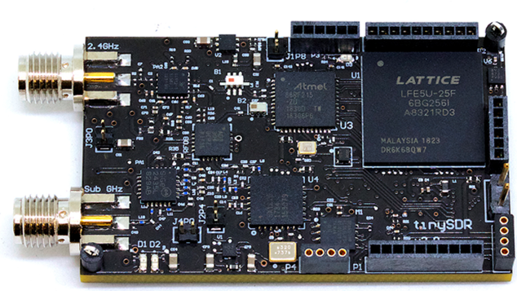
Our Solution: Compress Chunks of Firmware
Microcontroller
Flash
1
2
Memory
3
4
. . .
3
4
2
1
Compression
FPGA
1
2
3
4
. . .

Slide 18
Over-the-Air Update: Evaluation

Slide 19
Over-the-Air Update: Evaluation
FPGA: LoRa
FPGA: BLE
MCU: LoRa/BLE
1
0.8
CDF
0.6
0.4
0.2
0
0.5
1
1.5
2
2.5
3
3.5
4
Duration (minutes)
Update LoRa 2100 times and BLE 5600 times

Slide 20
TinySDR Architecture
FPGA
Physical Layer
2.4 GHz I/Q
Sub-GHz I/Q
ADC
Microcontroller
MAC Protocols
DAC
Flash
LoRa Radio
V_{MCU}
Controller
V_{FPGA}
.
.
Sensor
Over-the-Air
Programming
.
V_{Bat}
V_{PA}
Power
Management [30μW]

Slide 21
TinySDR
First low-power SDR platform which supports over-the-air update for PHY and MAC layers
30uW in sleep mode
10000x lower than existing platforms
Supports 900MHz and 2.4GHz ISM frequency bands, 4MHz bandwidth and digital/analog sensor interfaces
Has high sensitivities that match custom radio chipsets
-126 dBm sensitivity for LoRa at 6 Kbps
-94 dBm sensitivity for BLE beacon

